Slide 1

Hands-on Deep Learning with TensorFlow
GDG
Ahmedabad

Slide 2

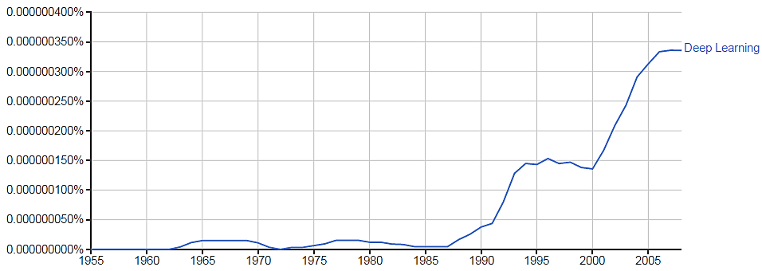

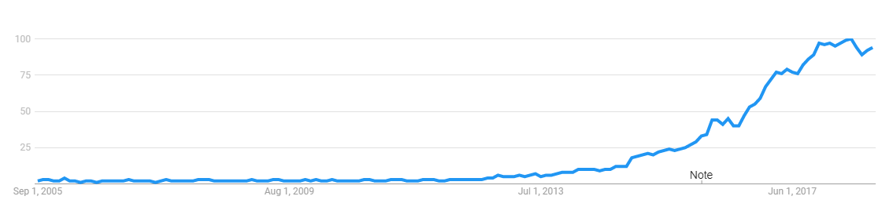
Interest
Google NGRAM & Google Trends
Trend of “Deep Learning” in Google Web Searches
Notes:
It takes 20 years to make an overnight success
In the case of Google Books Ngram Viewer, the text to be analyzed comes from the vast amount of books Google has scanned in from public libraries to populate their Google Books search engine. The y-axis indicates the relative frequency, in percentage terms, of the text being searched

Slide 3


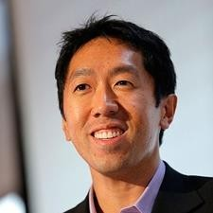

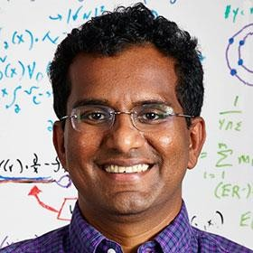
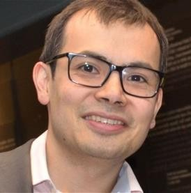
Hype or Reality?
Quotes
I have worked all my life in Machine Learning, and I have never seen one algorithm knock over benchmarks like Deep Learning
– Andrew Ng (Stanford & Baidu)
Deep Learning is an algorithm which has no theoretical limitations of what it can learn; the more data you give and the more computational time you provide, the better it is – Geoffrey Hinton (Google)
Human-level artificial intelligence has the potential to help humanity thrive more than any invention that has come before it – Dileep George (Co-Founder Vicarious)
For a very long time it will be a complementary tool that human scientists and human experts can use to help them with the things that humans are not naturally good – Demis Hassabis (Co-Founder DeepMind)
Notes:
Study about them

Slide 4

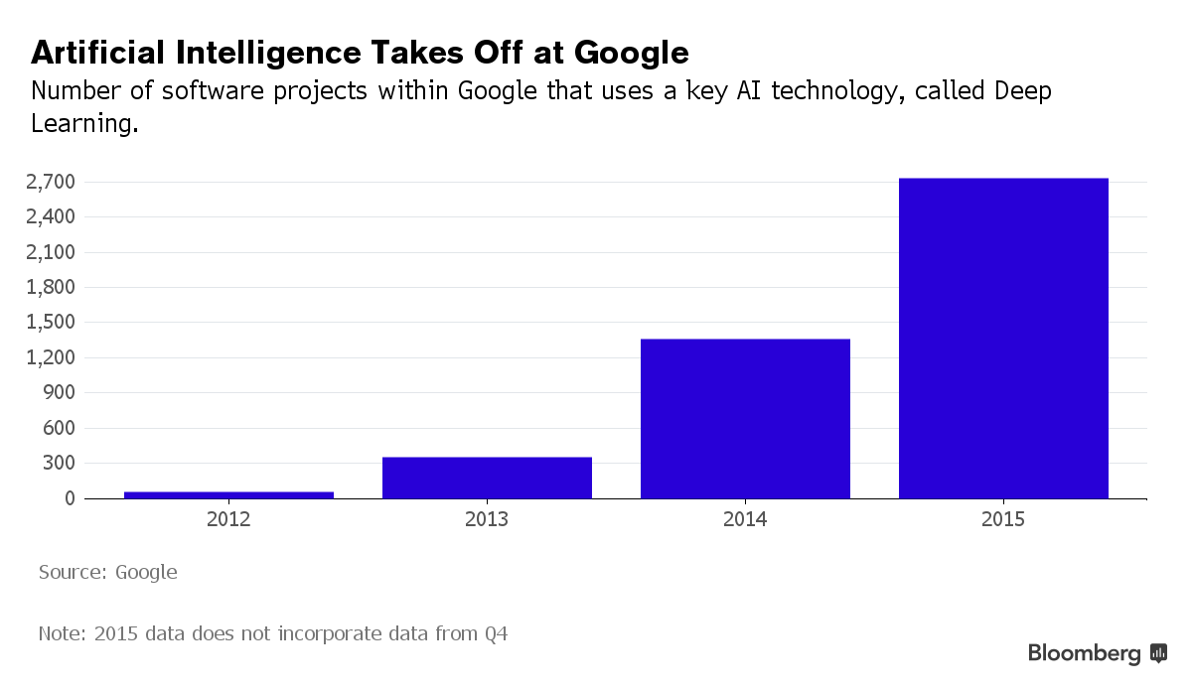
Hype or Reality?
Deep Learning at Google

Slide 5
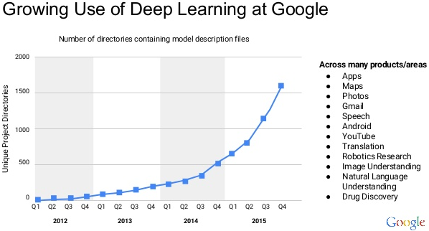
Hype or Reality?
Deep Learning at Google
Notes:
Study where exactly it is used

Slide 6


Notes:
Artificial Intelligence is on a rage! All of a sudden every one, whether understands or not, is talking about it. Understanding the latest advancements in artificial intelligence can seem overwhelming, but it really boils down to two very popular concepts Machine Learning and Deep Learning. But lately, Deep Learning is gaining much popularity due to it’s supremacy in terms of accuracy when trained with huge amount of data.

Slide 7
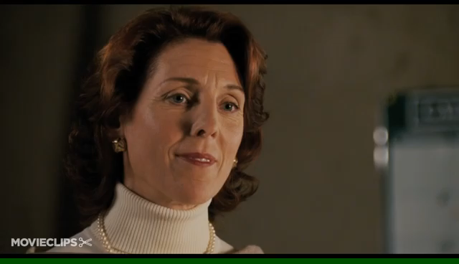
What is Learning?
A closer look at how Humans learn

Slide 8
Basic Terminologies
Features
Labels
Examples
Labelled example
Unlabelled example
Models (Train and Test)
Classification model
Regression model

Slide 9
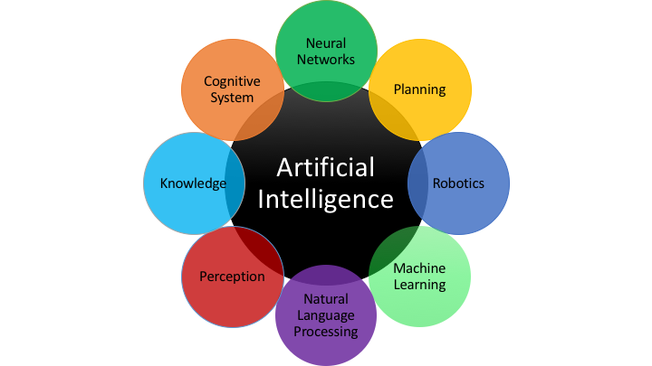
What is Artificial Intelligence?
Notes:
Mimics human behaviour, intelligence using logics and rules

Slide 10











Machine Learning - Basics
Introduction
Machine Learning is a type of Artificial Intelligence that provides computers with the ability to learn without being explicitly programmed.
Training Prediction
Provides various techniques that can learn from and make predictions on data
Labeled Data
Machine Learning
Algorithm
Data
Learned Model
Prediction
Notes:
Human: learn from experiences
Machine: follows instruction
When machine try to learn from exp. (data for it) that is ML

Slide 11




Machine Learning - Basics
Learning Approaches
Supervised Learning: Learning with a labeled training set
Example: email spam detector with training set of already labeled emails
Unsupervised Learning: Discovering patterns in unlabeled data
Example: cluster similar documents based on the text content
Reinforcement Learning: learning based on feedback or reward
Example: learn to play chess by winning or losing
Notes:
Supervised…learning with the help of a teacher
Reinfor…when we get start..gifts..trophy for doing good work…encourage them to do it

Slide 12

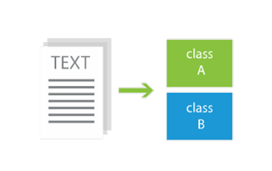
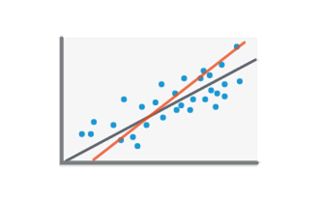
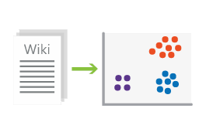
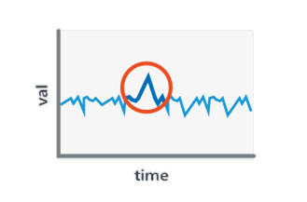
Machine Learning - Basics
Problem Types
Classification
(supervised – predictive)
Regression
(supervised – predictive)
Clustering
(unsupervised – descriptive)
Anomaly Detection
(unsupervised– descriptive)

Slide 13



What is Deep Learning?
Part of the machine learning field of learning representations of data. Exceptional effective at learning patterns.
Utilizes learning algorithms that derive meaning out of data by using a hierarchy of multiple layers that mimic the neural networks of our brain.
If you provide the system tons of information, it begins to
understand it and respond in useful ways.

Slide 14

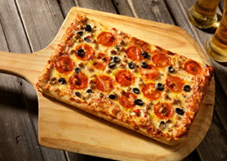
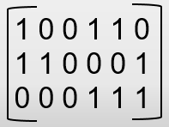





Feature Engineering
A machine learning model can't directly see, hear, or sense input examples. Machine learning models typically expect examples to be represented as numbered vectors
Feature engineering means transforming raw data into a feature vector of 1’s and 0’s which Machine can understand

Slide 15
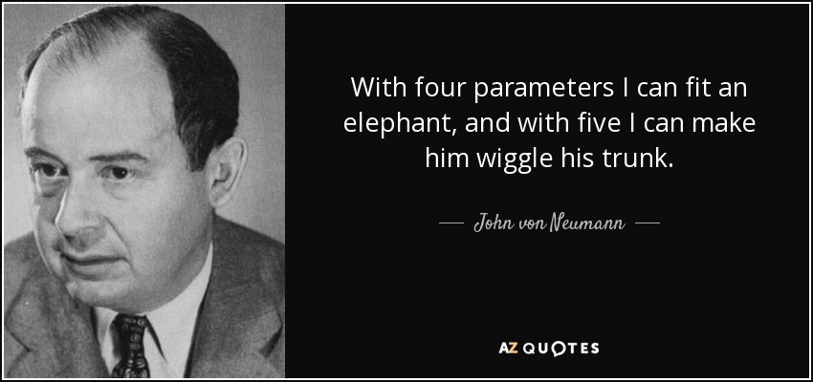
Notes:
Can you guess features for elephant?
The more features you have…the more it is good

Slide 16
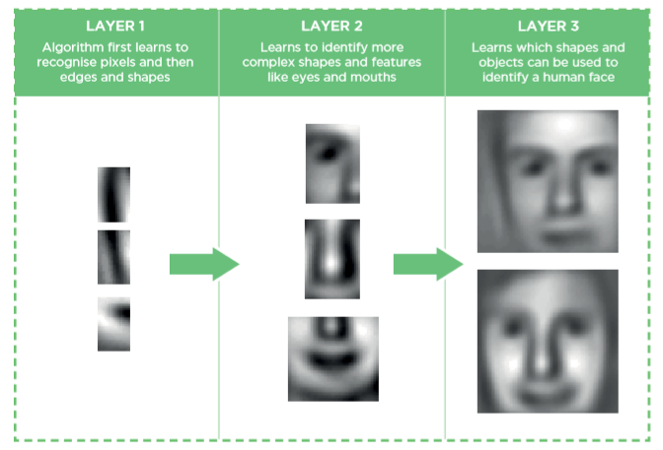
How does DL works?
Notes:
A deep neural network consists of a hierarchy of layers, whereby each layer transforms the input data into more abstract representations (e.g. edge -> nose -> face). The output layer combines those features to make predictions.
In the example of image recognition it means identifying light/dark areas before categorizing lines and then shapes to allow face recognition.

Slide 17
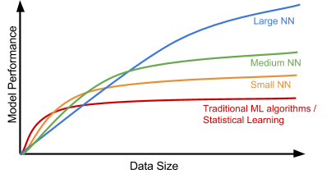
Why DL over traditional ML?
Machine Learning is set of algorithms that parse data, learn from them, and then apply what they’ve learned to make intelligent decisions
The thing about traditional Machine Learning algorithms is that as complex as they may seem, they’re still machine like
They need lot of domain expertise, human intervention only capable of what they’re designed for; nothing more, nothing less
For AI designers and the rest of the world, that’s where deep learning holds a bit more promise
Notes:
The “Big Data Era” of technology will provide huge amounts of opportunities for new innovations in deep learning.

Slide 18

Why DL over traditional ML?
Deep Learning requires high-end machines contrary to traditional Machine Learning algorithms
Thanks GPUs and TPUs
No more Feature Engineering!!
ML: most of the applied features need to be identified by an domain expert in order to reduce the complexity of the data and make patterns more visible to learning algorithms to work
DL: they try to learn high-level features from data in an incremental manner.
Notes:
GPU has become a integral part now to execute any Deep Learning algorithm
TPU (ASIC) by Google specifically for neural network implementation
This eliminates the need of domain expertise and hard core feature extraction

Slide 19
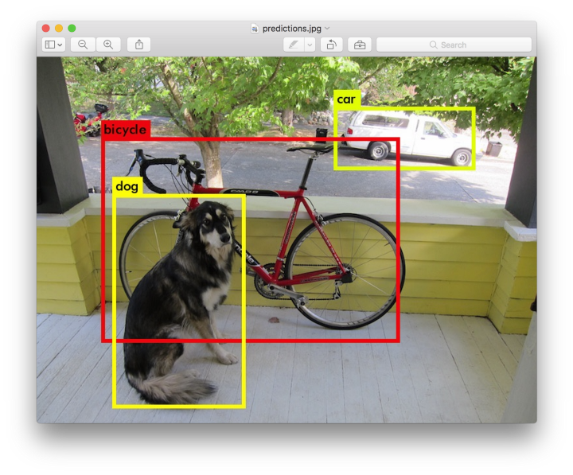
Why DL over traditional ML?
The problem solving approach:
Deep Learning techniques tend to solve the problem end to end
Machine learning techniques need the problem statements to break down to different parts to be solved first and then their results to be combine at final stage
For example for a multiple object detection problem, Deep Learning techniques like Yolo net take the image as input and provide the location and name of objects at output
But in usual Machine Learning algorithms uses SVM, a bounding box object detection algorithm then HOG as input to the learning algorithm in order to recognize relevant objects
Notes:
Harder problems such as video understanding and natural language processing will be successfully tackled by deep learning algorithms

Slide 20




What changed?
Old wine in new bottles
Big Data
(Digitalization)
Computation
(Moore’s Law, GPUs)
Algorithmic Progress

Slide 21
When to use DL or not over Others?
Deep Learning outperforms other techniques if the data size is large. But with small data size, traditional Machine Learning algorithms are preferable
Finding large amount of “Good” data is always a painful task but hopefully not now on, Thanks to the all new Google Dataset Search Engine ☺
Deep Learning techniques need to have high end infrastructure to train in reasonable time
When there is lack of domain understanding for feature introspection, Deep Learning techniques outshines others as you have to worry less about feature engineering
Model Training time: a Deep Learning algorithm may take weeks or months where as, traditional Machine Learning algorithms take few seconds or hours
Model Testing time: DL takes much lesser time as compare to ML
DL never reveals the “how and why” behind the output- it’s a Black Box
Deep Learning really shines when it comes to complex problems such as image classification, natural language processing, and speech recognition
Excels in tasks where the basic unit (pixel, word) has very little meaning in itself, but the combination of such units has a useful meaning
Notes:
ML: test time increases on increasing the size of data

Slide 22
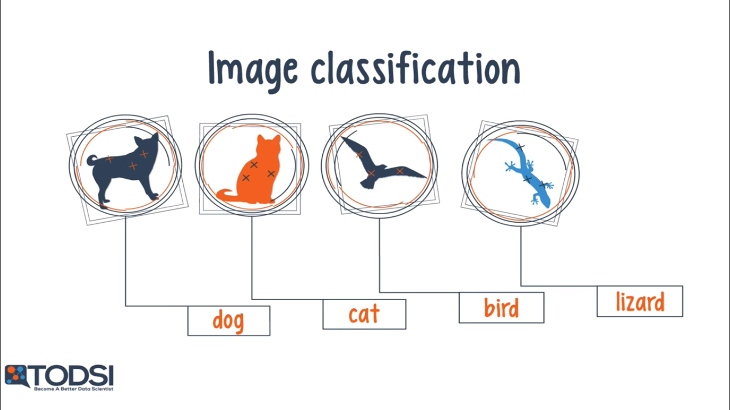
Got interested??
Applications of Deep Learning
Notes:
Img search system….automatic tagging…fb
Allows us to search img via standard query

Slide 23
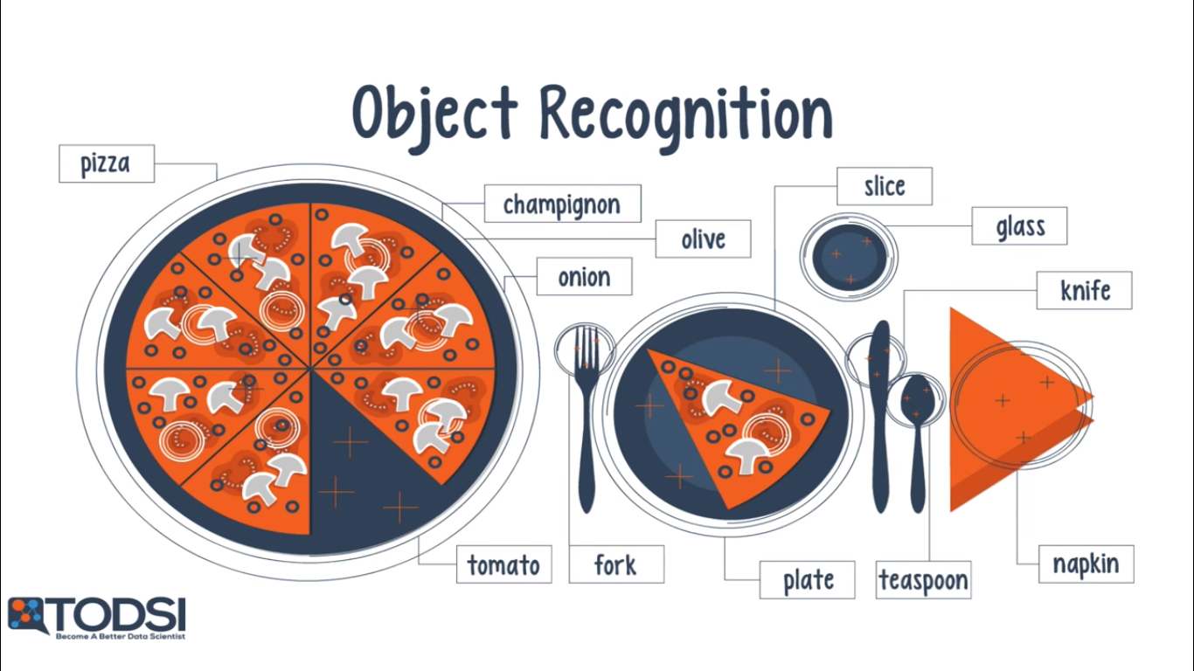
Try it yourself: https://www.clarifai.com/demo
Notes:
Google photos…find objects inside the image Uses CNN..
I am not a robot…why always find roads?...they are using us !!

Slide 24
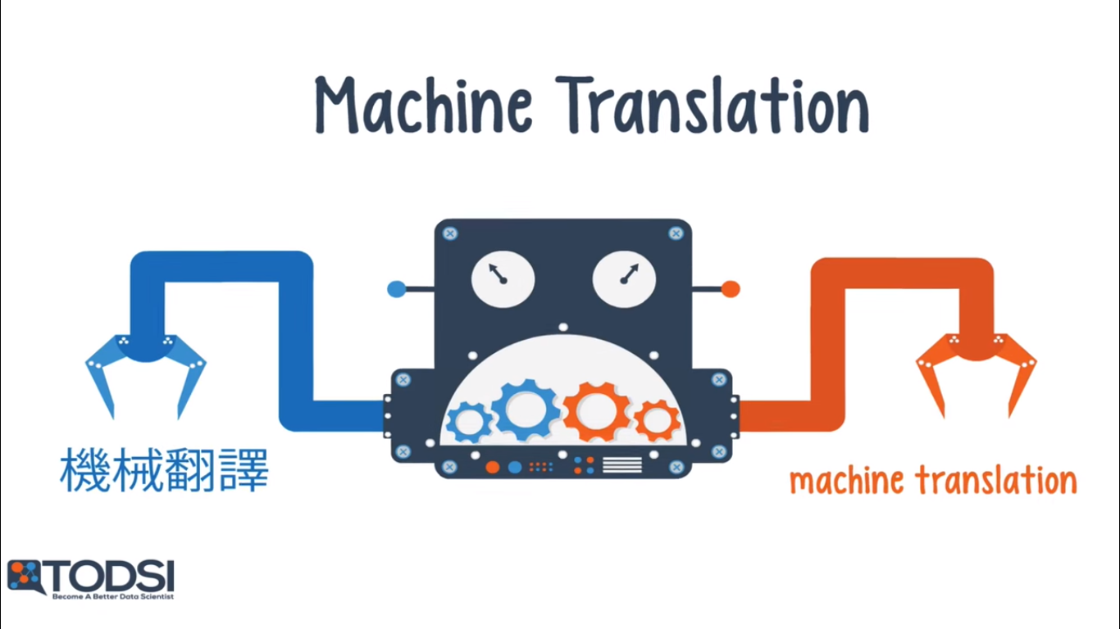
Applications
Deep Learning

Slide 25
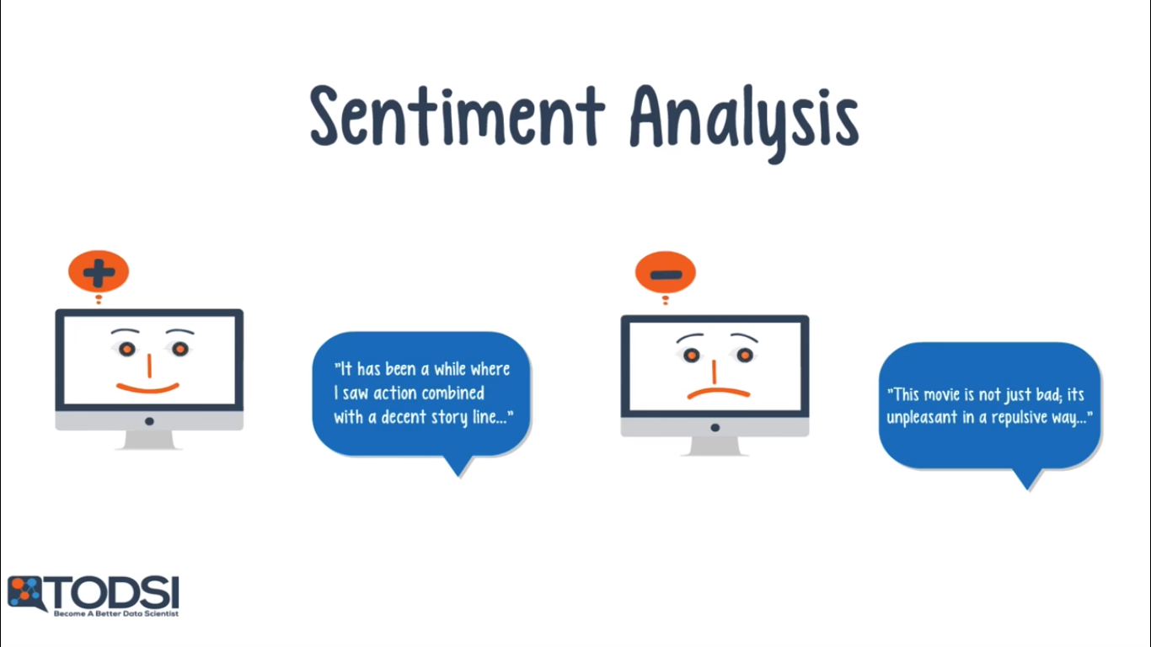
Try it yourself: https://www.paralleldots.com/sentiment-analysis
Notes:
LSTM
Movie reviews/ratings, new product interests

Slide 26
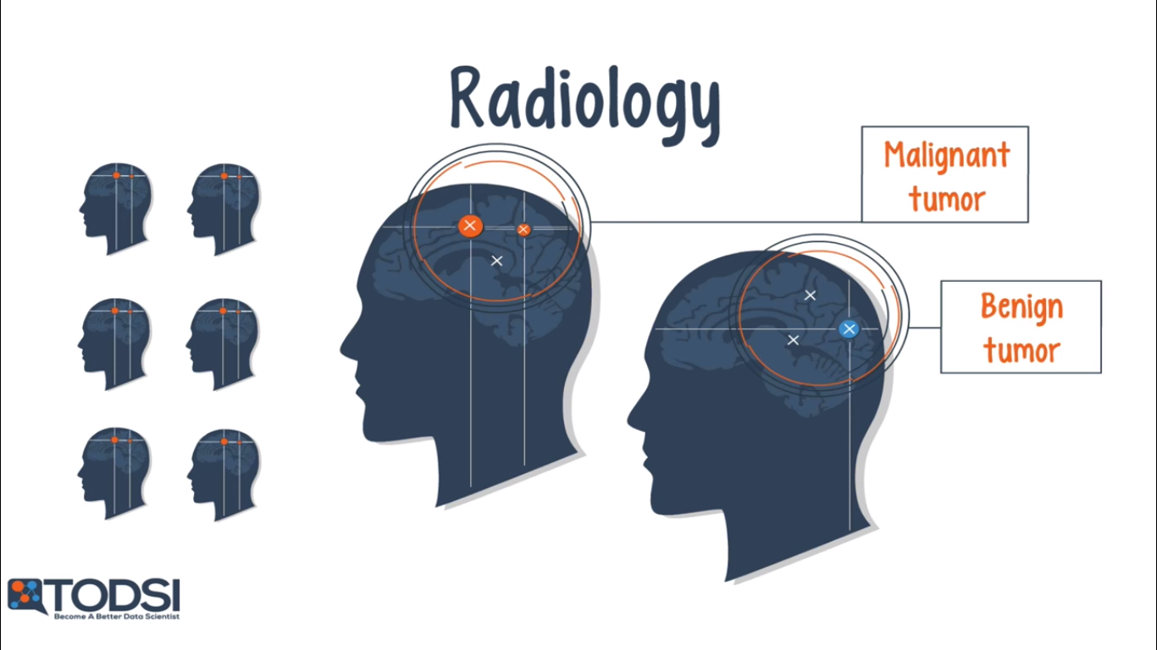
Applications
Deep Learning
Notes:
Mri, ct scan, fmri…my senior

Slide 27
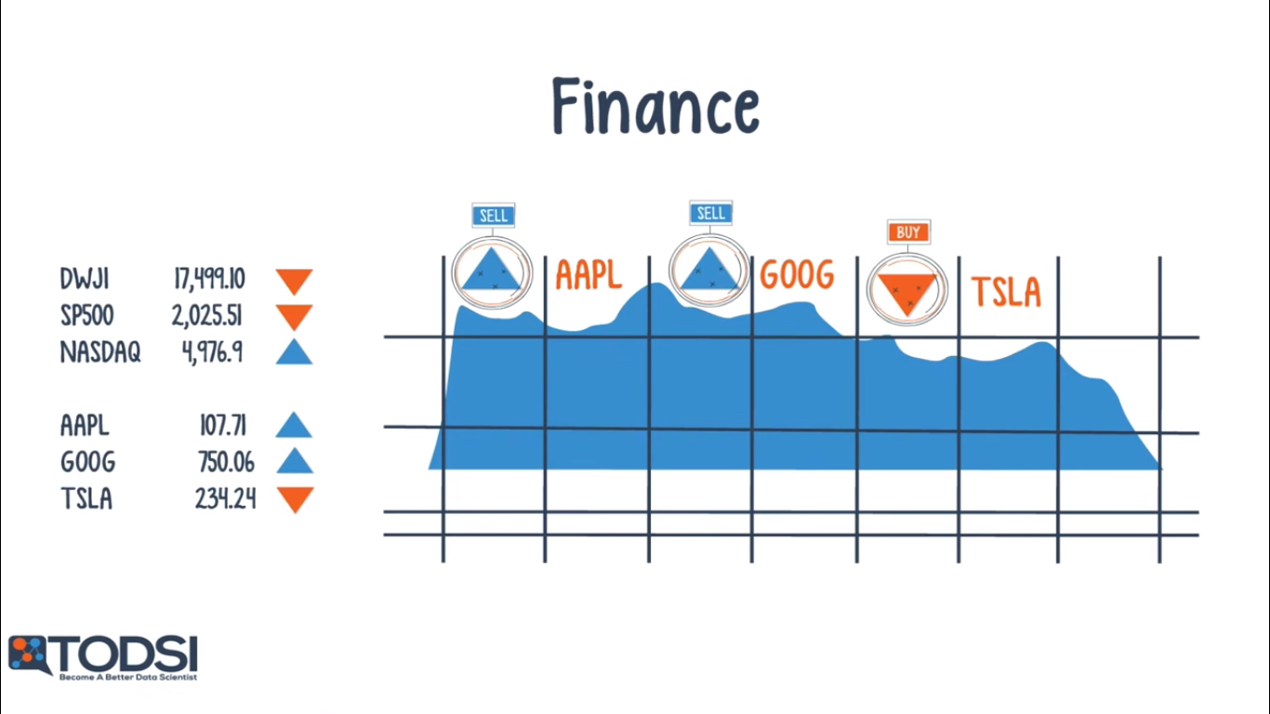
Applications
Deep Learning
Notes:
Buy,sell,,make predictions based on market data stream, portfolio allocation, and risk profiles
Useful in both Short term treding and long term investing

Slide 28
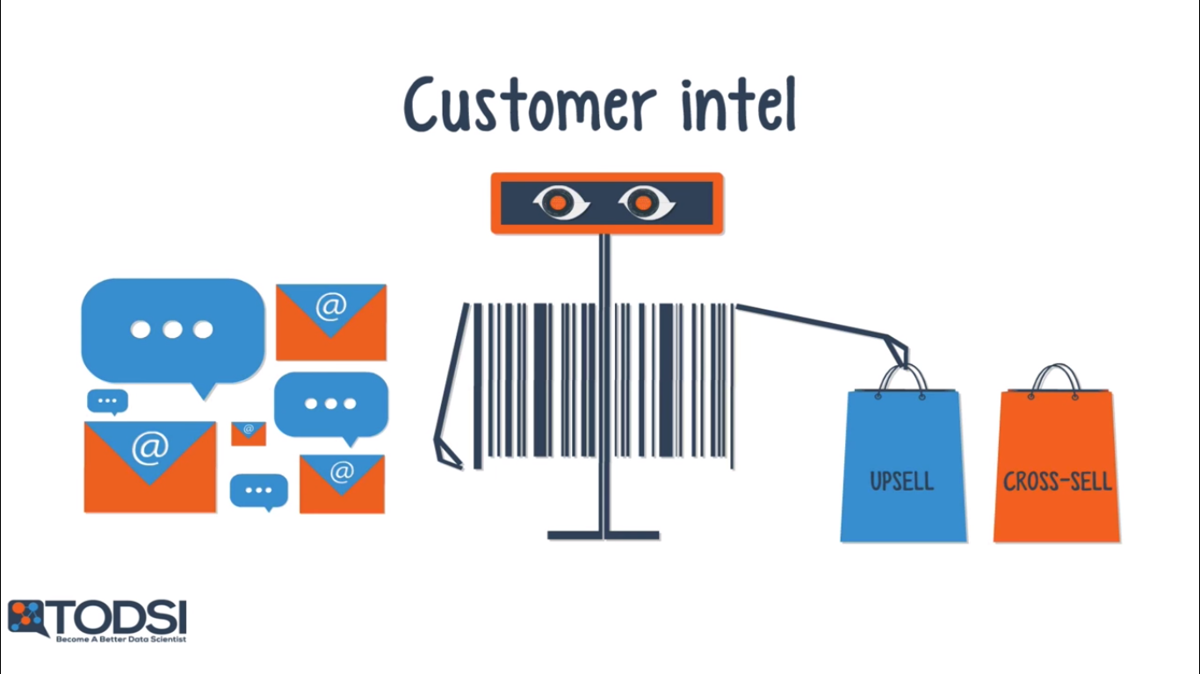
Applications
Deep Learning
Notes:
In malls, image processing, person identification, activity recognition….go towards which direction, which shop
past purches history, recommendation system
Find best selling stretegy

Slide 29






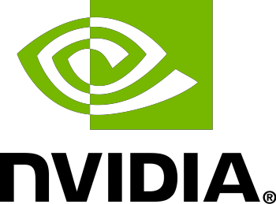

The Big Players
Companies
Notes:
Check: Where does they use ML/DL

Slide 30
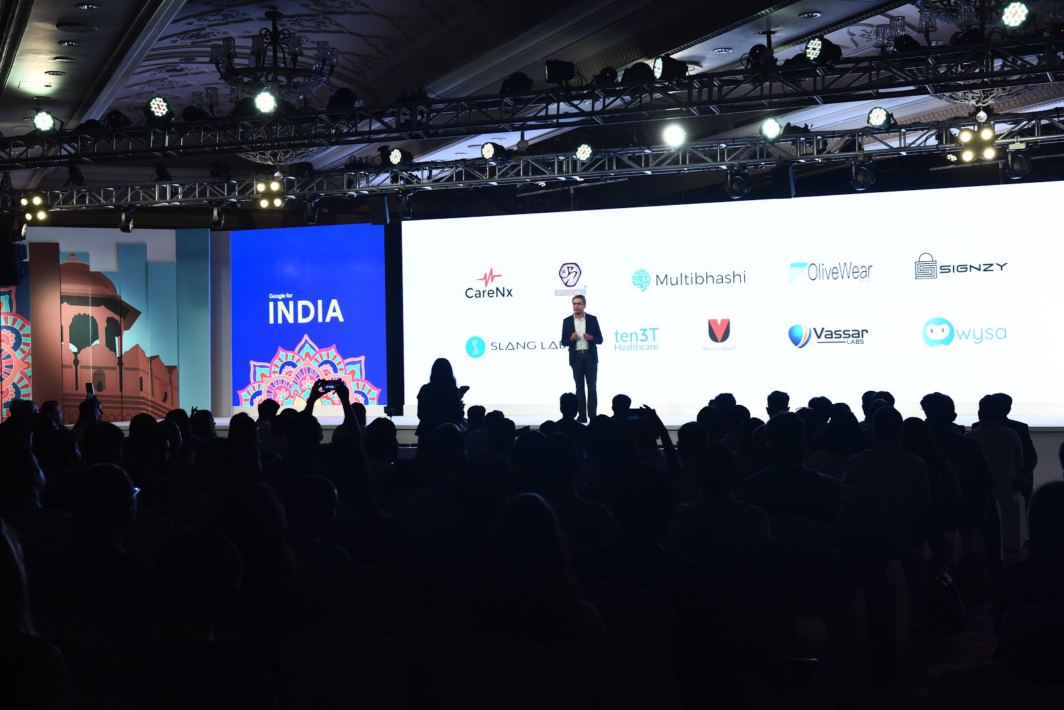
The Big Players
Indian Startups
Notes:
the first class of Launchpad Accelerator India
Google took 10 Indian startups under its wings to mentor them in the use of artificial intelligence and machine learning through its India-focused program Launchpad Accelerator, event was on august 31st
Key criteria for selection required India-only startups to be solving for India’s needs, with the use of advanced technologies such as AI/ML.
healthcare, agriculture, and fintech.
Uncanny Vision(Vehicle Analytics, People Analytics and Object Analytics), MultiBhashi(NLP), OliveWear(health), Vassar Labs(agriculture using satellite data)
Wysa: AI-based chat therapy for mental health, CareNx: Smartphone enabled fetal heart monitor for early detection of fetal asphyxia in babies
Signzy: solution ensuring digital trust using AI & Blockchain to provide smart e-verification and risk prediction.

Slide 31
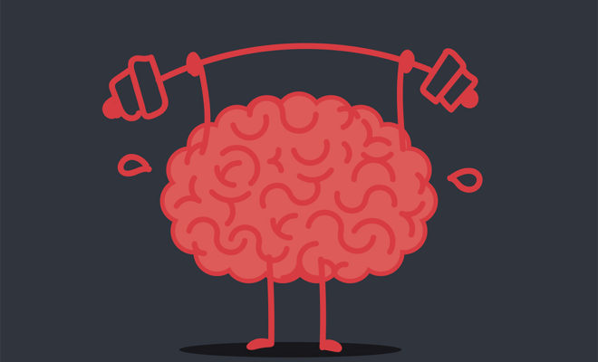
Notes:
Do you have any problem statement or you are working currently on that which can be solved using DL?

Slide 32

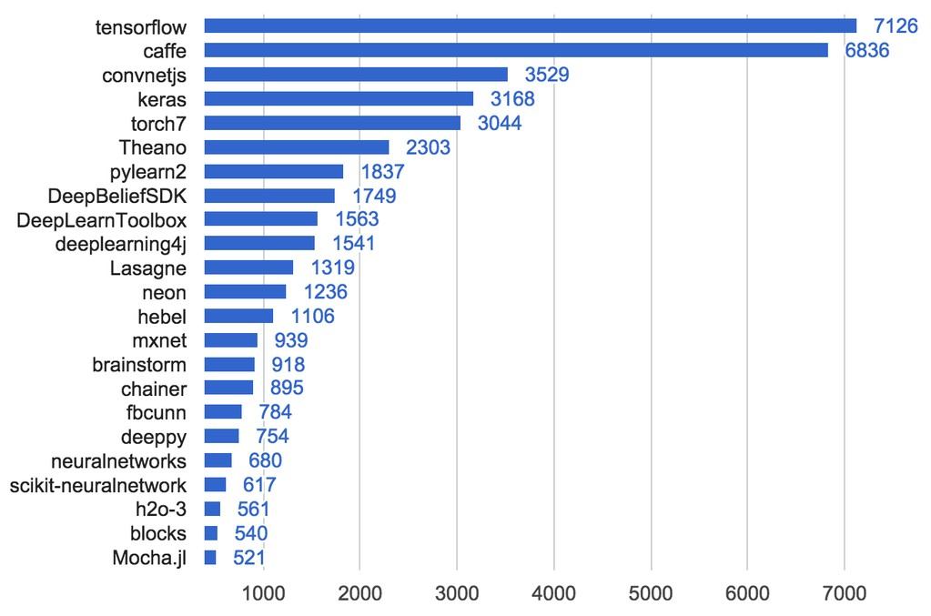
Deep Learning - Tools
Its all Open Source
Notes:
What is x axis?
Which years graph is this?

Slide 33


Slide 34

TensorFlow
TensorFlow is an open-source library for Machine Intelligence
It was developed by the Google Brain and released in 2015
It provides high-level APIs to help implement many machine learning algorithms and develop complex models in a simpler manner.
What is a tensor?
A mathematical object, analogous to but more general than a vector, represented by an array of components that are functions of the coordinates of a space.
TensorFlow computations are expressed as stateful dataflow graphs. The name TensorFlow derives from the operations that such neural networks perform on multidimensional data arrays known as ‘tensors’.

Slide 35
Why TensorFlow?
This is a dialogue between 2 persons on “Why Tensorflow?”
Person 1: Well it’s an ML framework!!
Person 2: But isn’t it is a complex one, I know a few which are very simple and easy to use like Sci-Kit learn, PyTorch, Keras, etc. Why to use Tensoflow?
Person 1: Ok, Can you implement your own Model in Sci-Kit learn and scale it if you want?
Person 2: No. Ok but then for Deep Learning, why not to use Keras or PyTorch? It has so many models already available in it.
Person 1: Tensorflow is not only limited to implementing your own models. It also has lot many models available in it. And apart from that you can do a large scale distributed model training without writing complex infrastructure around your code or develop models which need to be deployed on mobile platforms.
Person 2: Ok. Now I understand “Why Tensorflow?”

Slide 36
What TensorFlow does for You?
Calculation on large data set includes so much of boring Mathematics, Equations, etc.
Implementation of it from scratch all the time is a bit cumbersome task
Code will also be complex
TensorFlow is Scalable
What is Scalability?
Think of a Smart Traffic Management System of Ahmedabad city :D
Roads having 4 lanes, number of cross-roads, and not for a single area -> so much of Computation Data
Streaming data, Continues data, Decision in real-time
Single Computer cannot handle it
Solution?
Assign computers area/range wise then integrate all of them, this is no more a complex task today
Why?
TensorFlow will take care of it!!
It can scale the hardware/software requirements by clustering as per the requirement

Slide 37

What TensorFlow does for You?
Creates own environment, takes care of everything you will need!
Manage memory allocations
Create some variable, you can scale it, make them global
Statistical and Deep Learning both methods can be implemented
3D list, computation of Graph is fast because of the very powerful and Optimised Data Structure
Good for Research and Testing
Useful for Production level coding

Slide 38
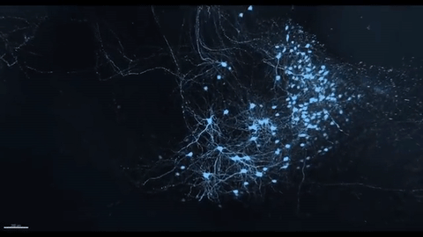

Slide 39
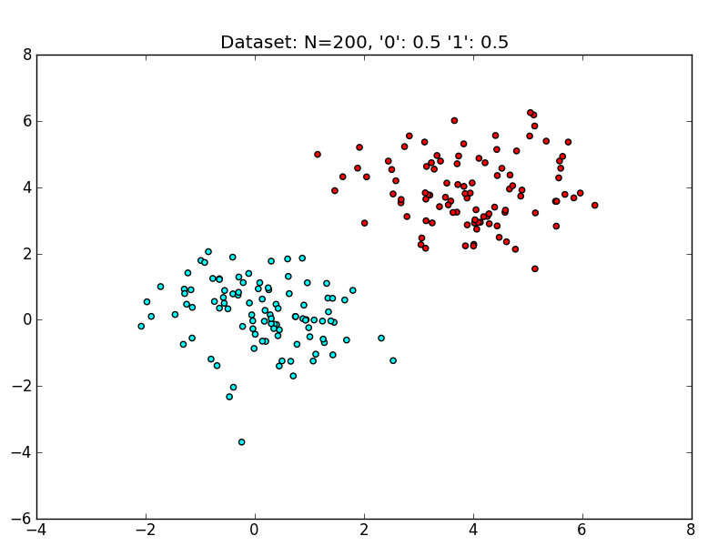
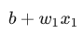
How do you Classify these Points?

Slide 40
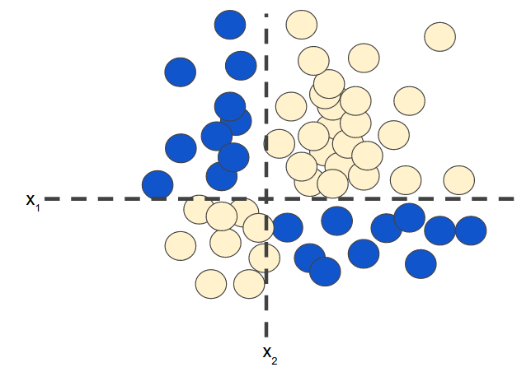
Okay, how do you Classify these Points?
Notes:
A feature cross is a synthetic feature that encodes nonlinearity in the feature space by multiplying two or more input features together. (The term cross comes from cross product.)

Slide 41
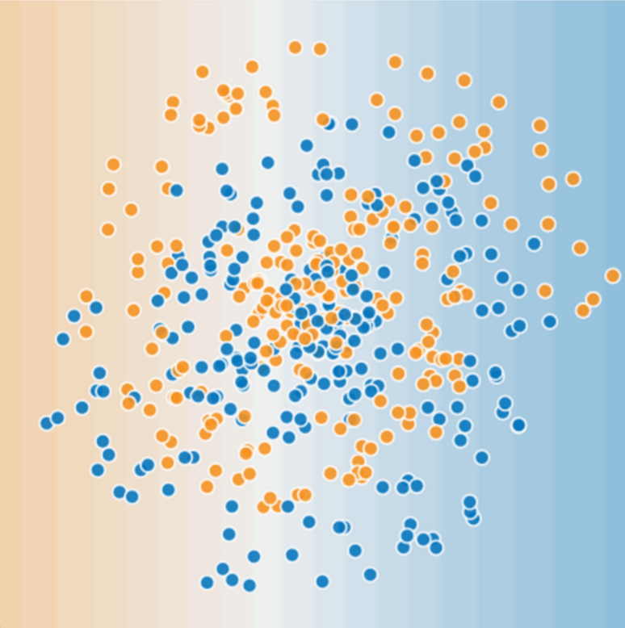
Okay okay, but now?
Non linearities are tough to model. In complex datasets, the task becomes very cumbersome. What is the solution?

Slide 42


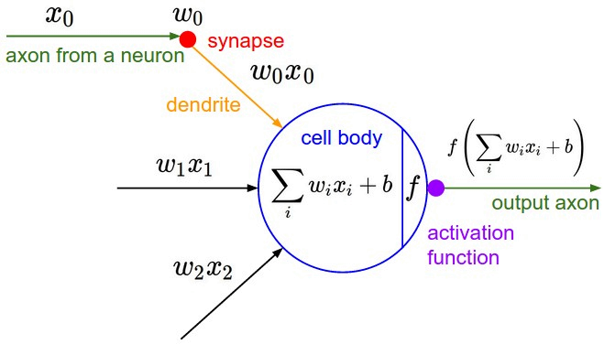


Inspired by the human Brain
An artificial neuron contains a nonlinear activation function and has
several incoming and outgoing weighted connections.
Neurons are trained to filter and detect specific features or patterns (e.g. edge, nose) by receiving weighted input, transforming it with the activation function und passing it to the outgoing connections.
Notes:
The first hierarchy of neurons that receives information in the visual cortex are sensitive to specific edges while brain regions further down the visual pipeline are sensitive to more complex structures such as faces.

Slide 43
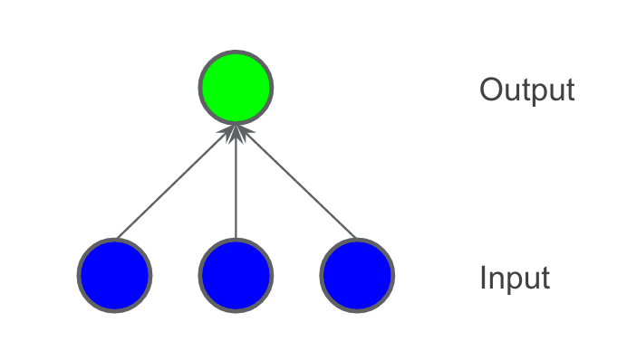
Modelling a Linear Equation

Slide 44
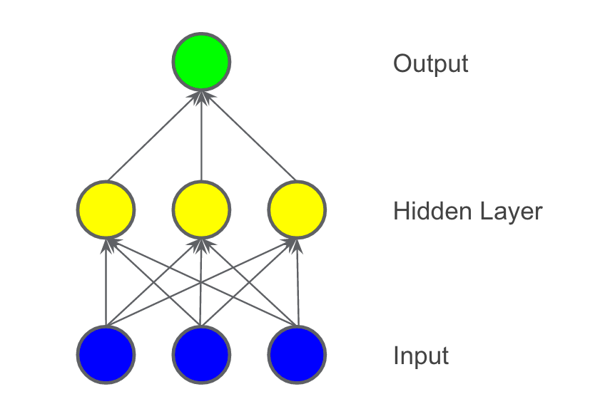
How to deal with Non-linear Problems?
We added a hidden layer of intermediary values. Each yellow node in the hidden layer is a weighted sum of the blue input node values. The output is a weighted sum of the yellow nodes.
Notes:
Is the model linear?

Slide 45
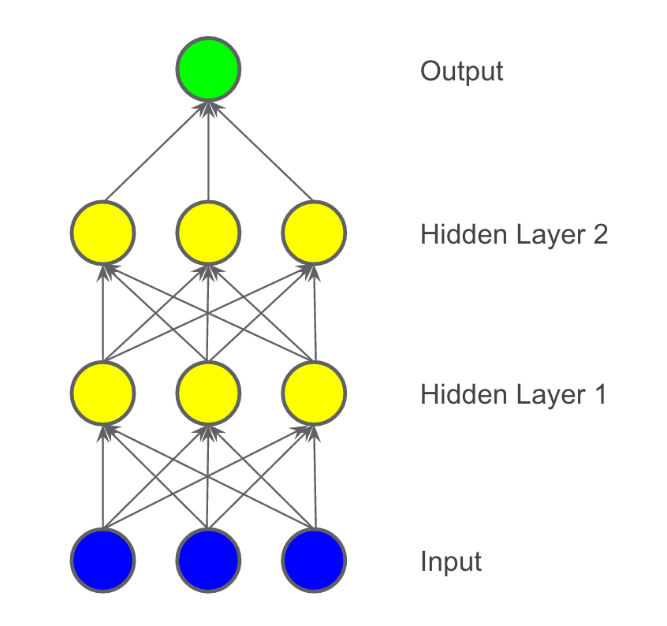

Is it linear? What are we missing?

Slide 46
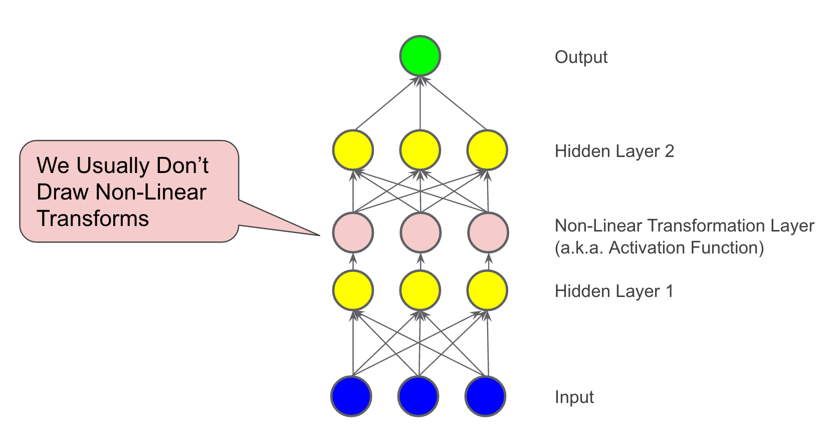

Activation Functions
Non-linearity is needed to learn complex (non-linear) representations of data, otherwise the NN would be just a linear function.

Slide 47


Slide 48
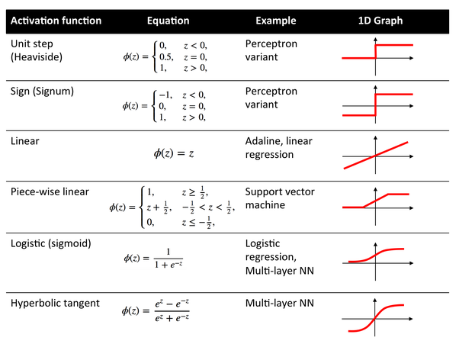
Non-linear Activation Functions

Slide 49

Gradient Descent
Gradient Descent finds the (local) minimum of the cost function (used to
calculate the output error) and is used to adjust the weights
Notes:
the resulting plot of loss vs. w1 will always be convex. In other words, the plot will always be bowl-shaped, kind of like this:

Slide 50
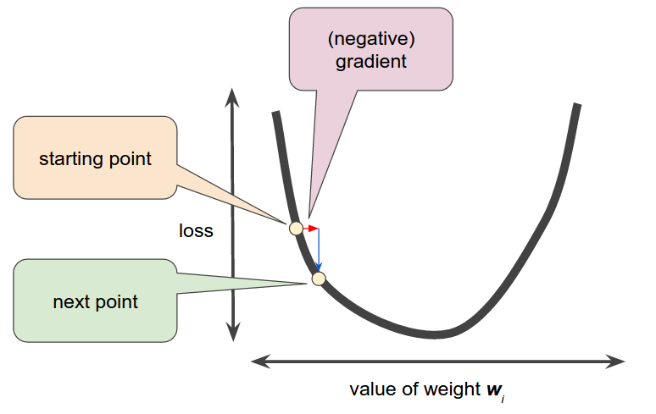
Gradient Descent
Convex problems have only one minimum; that is, only one place where the slope is exactly 0. That minimum is where the loss function converges
The gradient descent algorithm then calculates the gradient of the loss curve at the starting point. In brief, a gradient is a vector of partial derivatives
A gradient is a vector and hence has magnitude and direction
The gradient always points in the direction of the minimum. The gradient descent algorithm takes a step in the direction of the negative gradient in order to reduce loss as quickly as possible

Slide 51
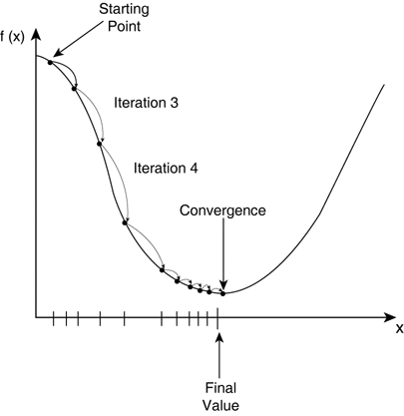
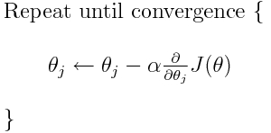
Gradient Descent
The algorithm given below signifies Gradient
Descent algorithm
In our case,
Ө_{j} will be w_{i}
𝞪 is the learning rate
J(Ө) is the cost function

Slide 52
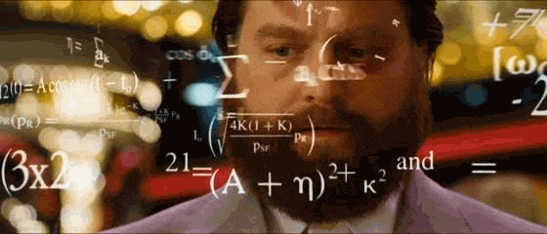
Notes:
LSTM
Movie reviews/ratings, new product interests

Slide 53
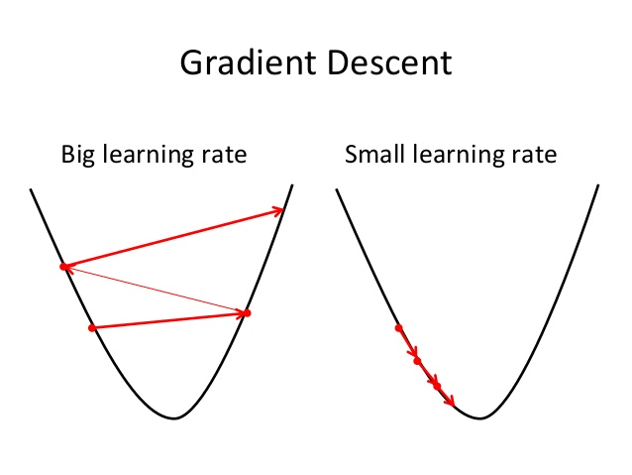
The Learning Rate
Gradient descent algorithms multiply the gradient by a scalar known as the learning rate (also sometimes called step size) to determine the next point.
For example, if the gradient magnitude is 2.5 and the learning rate is 0.01, then the gradient descent algorithm will pick the next point 0.025 away from the previous point.
A Hyperparameter!
Think of it as in real life. Some of us slow learners while some others are quicker learners
Small learning rate -> learning will take too long
Large learning rate -> may overshoot the minima

Slide 54

But how the model will LEARN?
BACKPROPAGATION

Slide 55






Deep Learning
The Training Process
Sample labeled data
Forward it trough the network to get predictions
Update the connection weights
Backpropagate the errors
Learns by generating an error signal that measures the difference between the predictions of the network and the desired values and then using this error signal to change the weights (or parameters) so that predictions get more accurate.

Slide 56
Still not so Perfect! Backprop can go wrong
Vanishing Gradients:
The gradients for the lower layers (closer to the input) can become very small. In deep networks, computing these gradients can involve taking the product of many small terms
Exploding Gradients:
If the weights in a network are very large, then the gradients for the lower layers products of many large terms. In this case you can have exploding gradients: gradients that get too large to converge

Slide 57
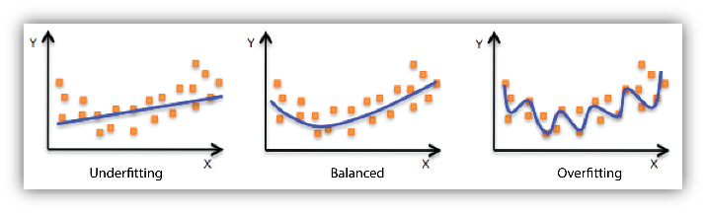
Ooooooverfitting = Game Over
An overfit model gets a low loss during training but does a poor job predicting new data
Overfitting is caused by making a model more complex than necessary.
The fundamental tension of machine learning is between fitting our data well, but also fitting the data as simply as possible

Slide 58
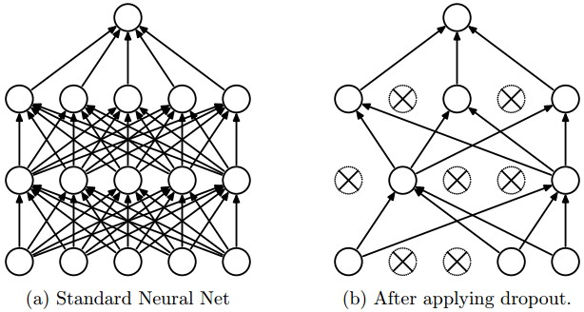
Solution Dropout Regularization
It works by randomly "dropping out" unit activations in a network for a single gradient step. The more you drop out, the stronger the regularization:
0.0 -> No dropout regularization.
1.0 -> Drop out everything. The model learns nothing
values between 0.0 and 1.0 -> More useful

Slide 59
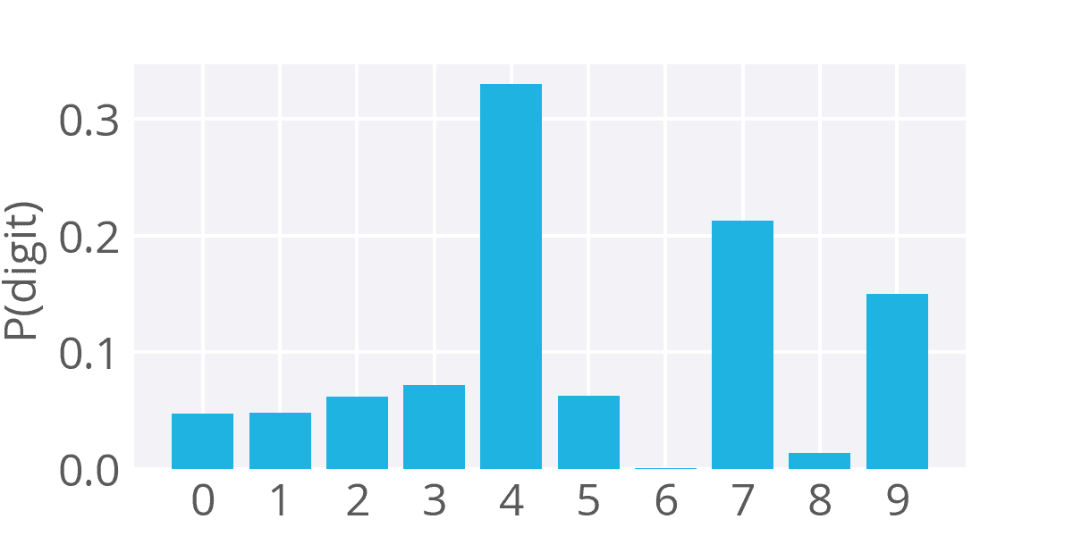

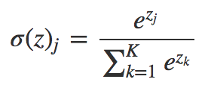
Softmax
Now the problem with sigmoid function in multi-class classification is that the values calculated on each of the output nodes may not necessarily sum up to one.
The softmax function used for multi-classification model returns the probabilities of each class.

Slide 60
Game Time!!
Visit kahoot.it
Game PIN: 508274

Slide 61

Convolutional Neural Nets (CNN)
Convolution layer is a feature detector that automagically learns to filter out not
needed information from an input by using convolution kernel.
Pooling layers compute the max or average value of a particular feature over a region of the input data (downsizing of input images). Also helps to detect objects in some unusual places and reduces memory size.

Slide 62

Convolution…! ;)

Slide 63

Convolution

Slide 64

Max Pooling

Slide 65
Let’s build our first CNN
Visit: https://colab.research.google.com/drive/1arAJnnTn0wI3KoSSJHg_Hjw40VPPMtP0

Slide 66




Takeaways
Humans are genius!!!
Machines that learn to represent the world from experience.
Deep Learning is no magic! Just statistics in a black box, but
exceptional effective at learning patterns.
We haven’t figured out creativity and human-empathy.
Neural Networks are not the solution to every problem.
Transitioning from research to consumer products. Will make the
tools you use every day work better, faster and smarter.

Slide 67
This was just a Start! Online Courses
DL Specialization: https://www.deeplearning.ai/
Deep Learning A-Z™: Hands-On Artificial Neural Networks: https://www.udemy.com/deeplearning/?siteID=AKW.sgcfqI8oqN6eoMfxusNIligTml0Iw&LSNPUBID=AKW*sgcfqI8
The Canonical Machine Learning Course: https://www.coursera.org/learn/machine-learning
CMU ML Course: http://www.cs.cmu.edu/~tom/10701_sp11/lectures.shtml
University of Washington: https://www.coursera.org/learn/ml-foundations

Slide 68
This was just a Start! Visit Blogs
Machine Learning Google News
Machine Learning Mastery
Medium: https://medium.com/towards-data-science/machine-learning/home
Andej Karpathy: http://karpathy.github.io/
I am Trask: http://iamtrask.github.io/
Quora: https://www.quora.com/topic/Machine-Learning
AI StackExchange: https://ai.stackexchange.com/

Slide 69
This was just a Start! Useful Links (Extremely!)
Over 200 of the Best Machine Learning, NLP, and Python Tutorials: https://medium.com/machine-learning-in-practice/over-200-of-the-best-machine-learning-nlp-and-python-tutorials-2018-edition-dd8cf53cb7dc
Awesome Deep Learning: https://github.com/ChristosChristofidis/awesome-deep-learning
Machine Learning Glossary: https://developers.google.com/machine-learning/glossary/

Slide 70
References
https://towardsdatascience.com/why-deep-learning-is-needed-over-traditional-machine-learning-1b6a99177063
https://iamtrask.github.io/2015/07/12/basic-python-network/
https://www.youtube.com/watch?v=BmkA1ZsG2P4
https://www.slideshare.net/LuMa921/deep-learning-a-visual-introduction?from_action=save
https://developers.google.com/machine-learning/crash-course/

Slide 71


Questions…??
Comments
Suggestions ☺

Slide 72

Happy Learning!
Charmi Chokshi
AI and Data Enthusiast
Final year ICT Engineering student at Ahmedabad University
Let’s Connect!
LinkedIn
Github
GDG
Ahmedabad

